Slide 1
Design Document for ASEE robotics competition
Sponsor: Michael Golub, IUPUI Department of Mechanical Engineering migolub@iupui.edu
Group Members: Blake bennett, dallas thornton, glenn haag, torben eid 4/27/2018

Slide 2
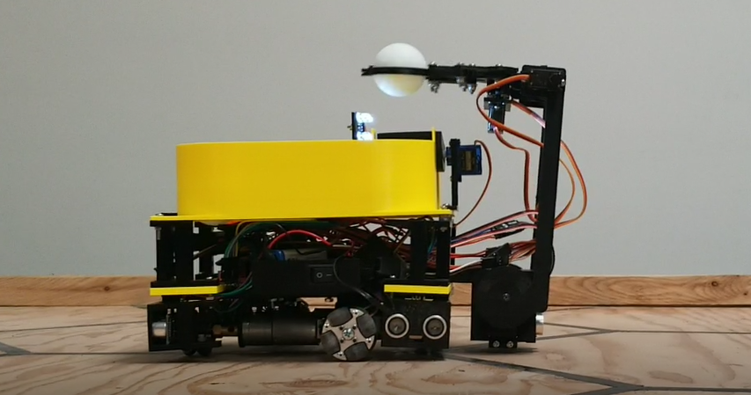
Project motivation
Blake Bennett
Increase the interest in Robotics at IUPUI.
Increase the reputation of IUPUI Robotics.
Educate underclassmen in the principles of robotic design.

Slide 3
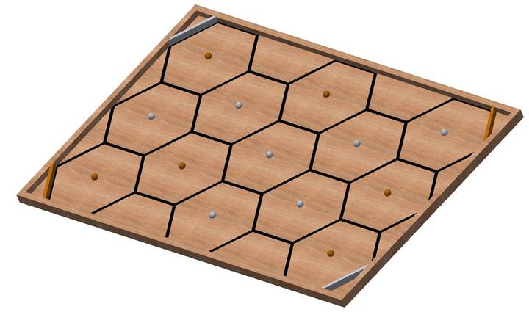
Project background information
Blake Bennett
American Society of Engineering Education (ASEE) hosts a yearly competition.
An autonomous robot will mimic a worker bee collecting honey in a hive.
Points will be awarded based on the number of ping pong balls correctly placed in the corner pockets.
10 for correct placement, 5 for incorrect corner placement
2018 ASEE Competition Track

Slide 4
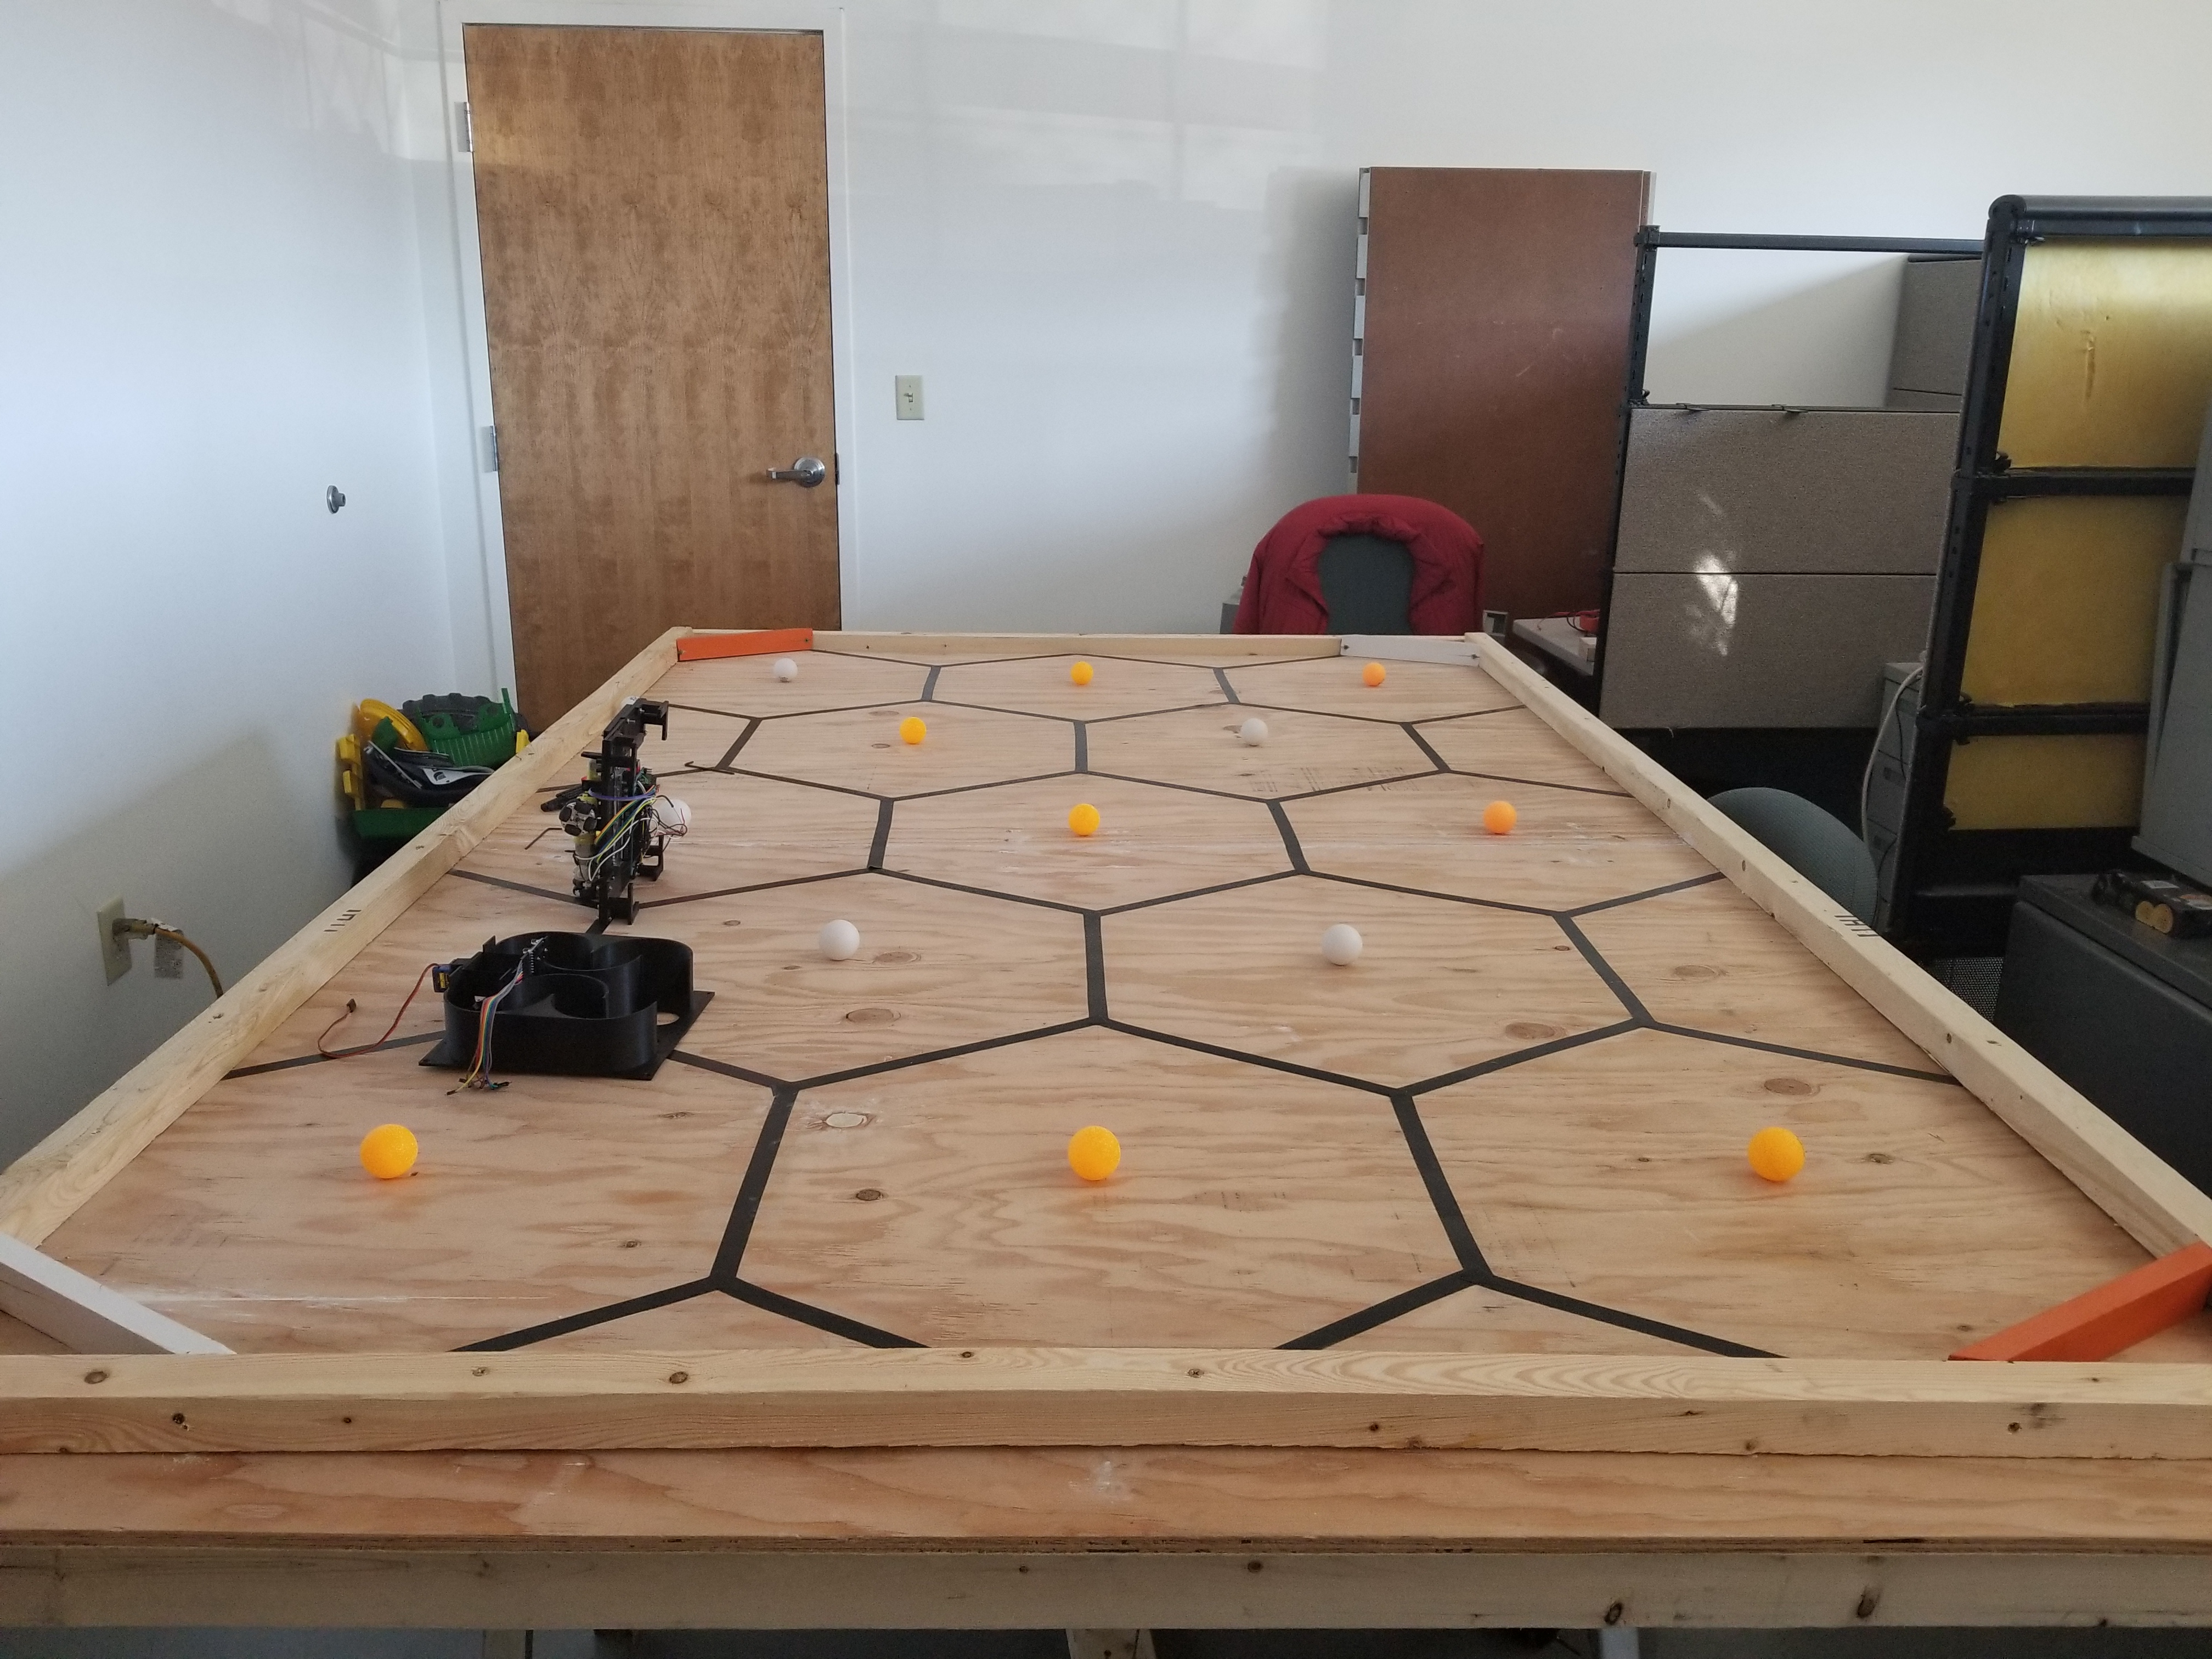
ASEE Competition track
Blake Bennett

Slide 5
Technical requirements and Constraints
Blake Bennett
Robot SHALL be completely autonomous.
Robot SHALL retrieve all 13 balls on the track without damaging them.
Robot SHALL NOT damage the track in any capacity.
Robot SHALL be at most 8”X12”X10” to start, but may expand during the run.
Teams SHALL NOT use and robotic kits in any capacity.
Total cost of purchases SHALL NOT exceed $400.
Robot SHALL NOT fly or give off emissions of any kind (solid/liquid/gaseous).

Slide 6
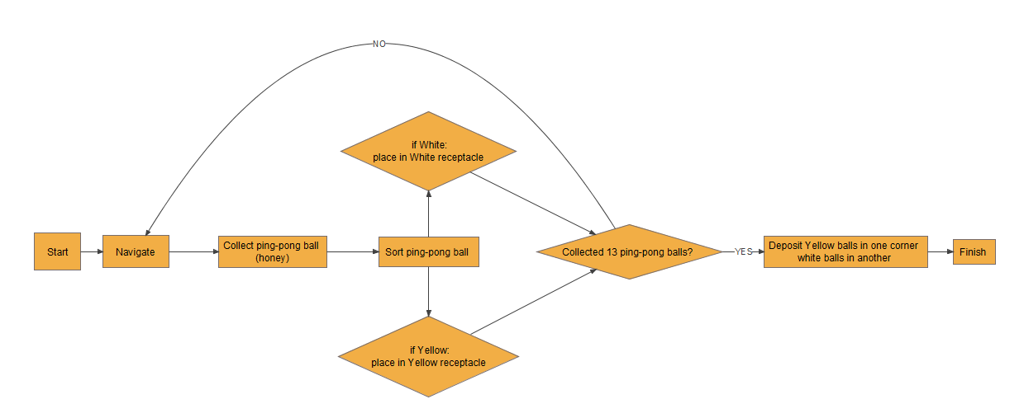
Robot Process Flow Diagram
Blake Bennett

Slide 7
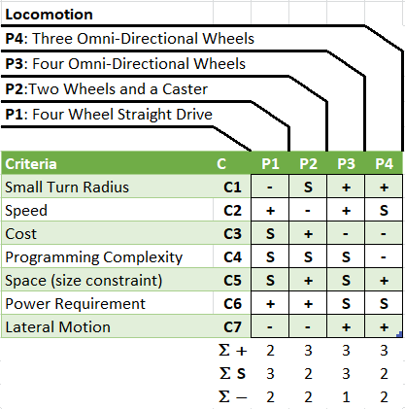
Locomotion
Dallas Thornton
Four Omni-Directional Wheels
Wheels are placed at 90 degree angles with respect to each other.
Provides the best turning control and the easiest implementation of software.

Slide 8
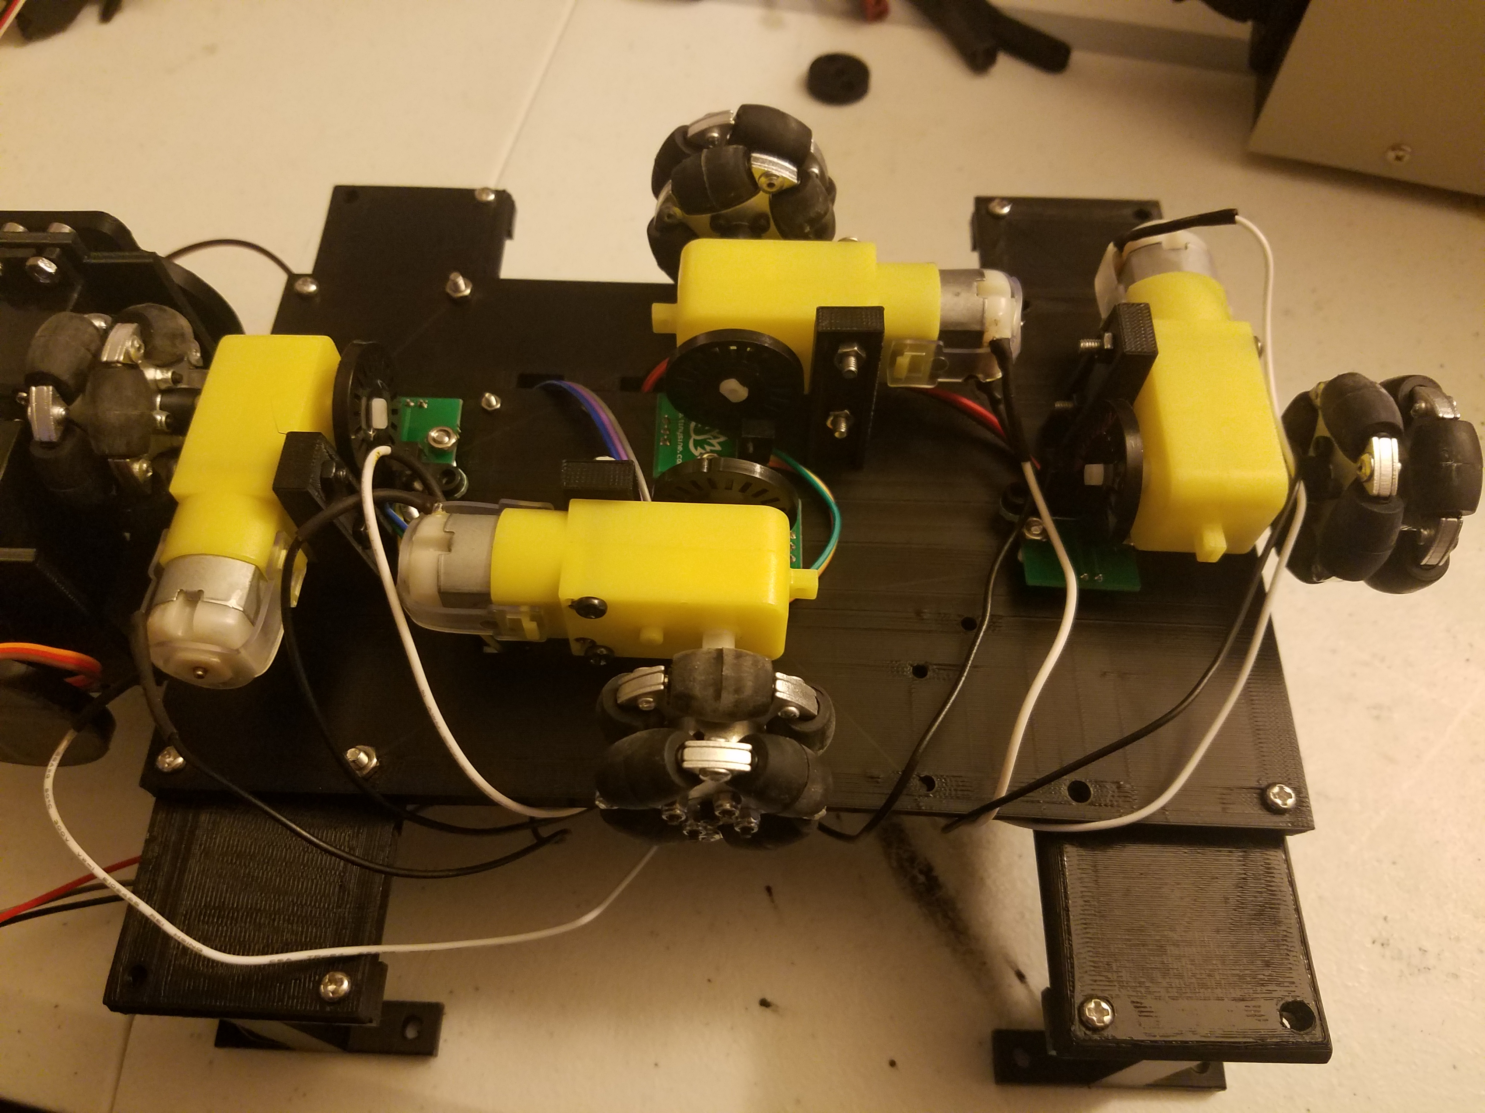
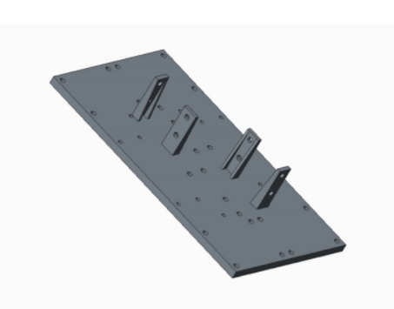
Dallas Thornton
Locomotion Models

Slide 9
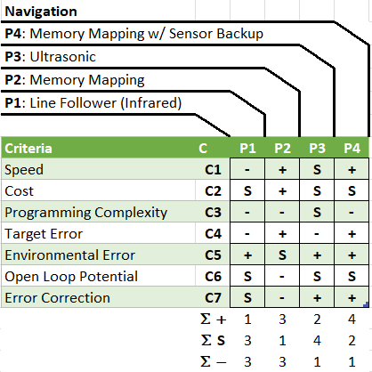
navigation
Dallas Thornton
Memory Mapping with Sensor Backup
Error checking done using an array of ultrasonic sensors and an MPU6050 (accelerometer, gyroscope, magnetometer).
Allows for quick completion time, while also allowing the robot to recover from incremental error in mapping algorithm

Slide 10
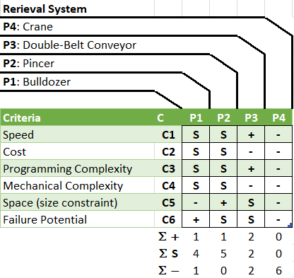
Retrieval system
Torben Eid
Pincer design
Two points of articulation on the retriever arm to meet height constraint as well as position the arm over the sorting subsystem.
Pincer will grab ball and raise to drop the ball into the sorting sub-system’s flipper.
The pincer is designed such that the inner diameter is exactly the size of a ping pong ball (40mm).

Slide 11
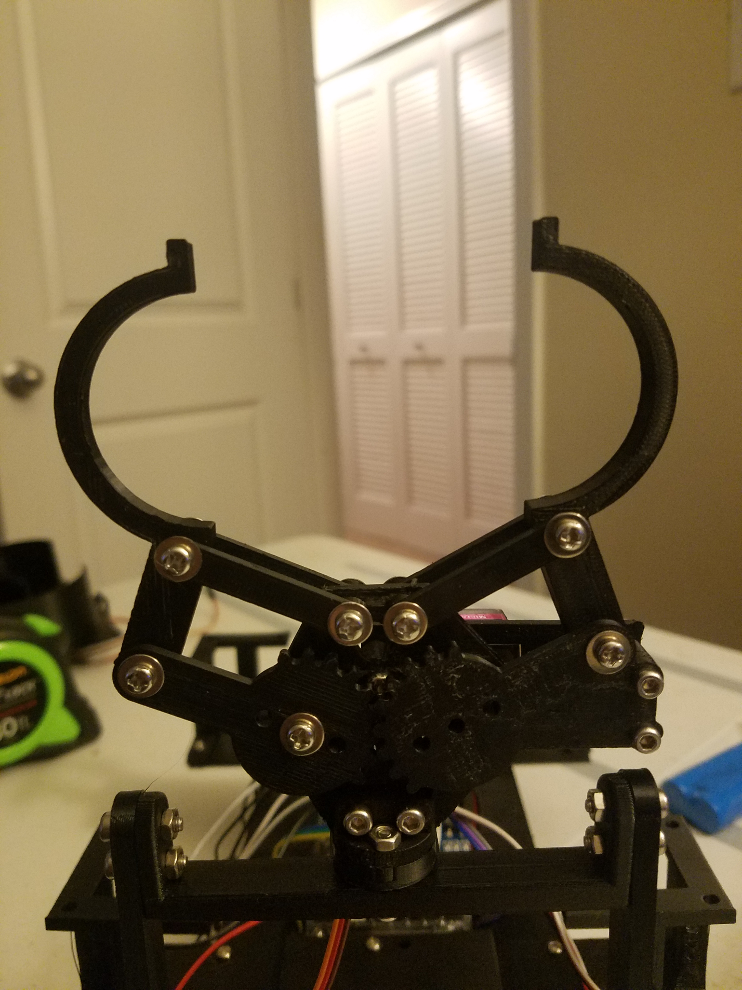
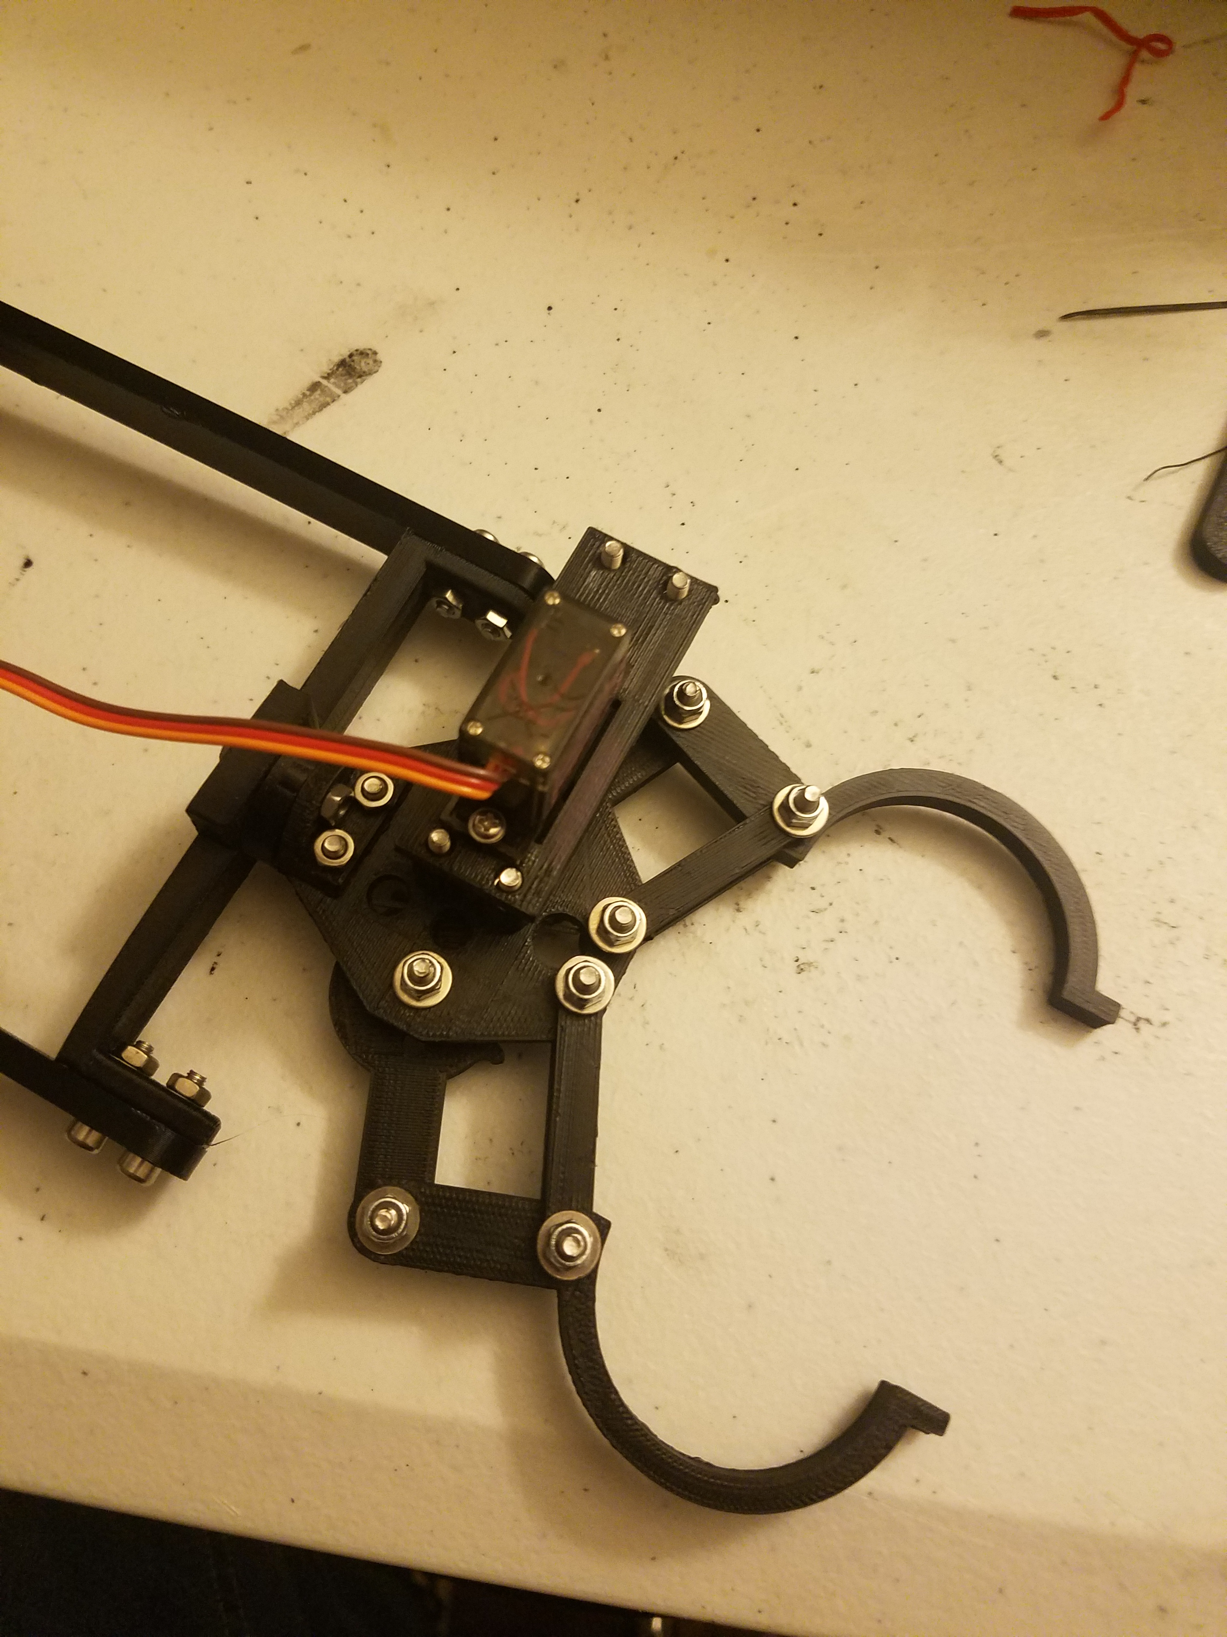
Retrieval system
Torben Eid

Slide 12
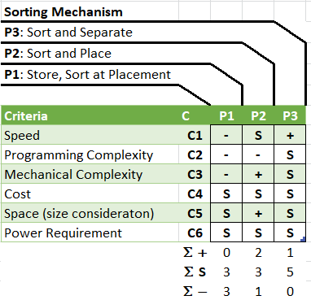
Sorting mechanism
Torben Eid
Sort and Separate
TCS3200 Color light-to-frequency converter is used to determine the color of the two different ping pong balls.
A servo is attached to a cup that will turn to direct the ball to its respective curved tunnel, based on TCS3200 output signal.
Utilizes a folded tunnel design that mimics the human intestines to conserve space.
Saves time by sorting all balls before placement.

Slide 13
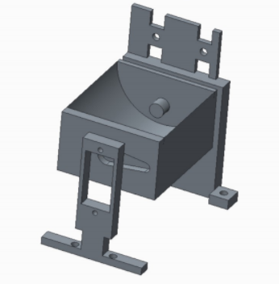
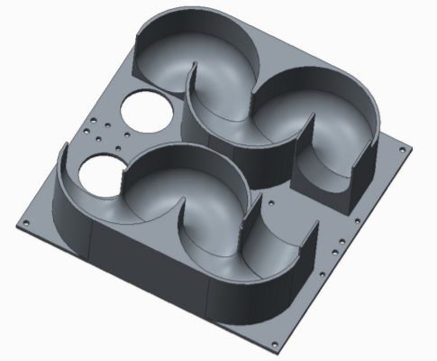
Sorting mechanism
Torben Eid

Slide 14
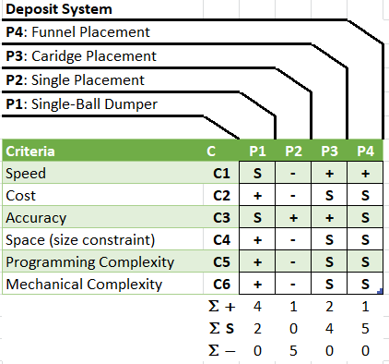
Deposit system
Glenn Haag
Single-ball dumping system
Each color set is placed in a tunnel that holds all of the balls of that color until all balls have been retrieved.
One ball at a time will be fed through the hole at the end of the tube to be deposited.
Servo motors actuate a lever that ejects the balls.

Slide 15
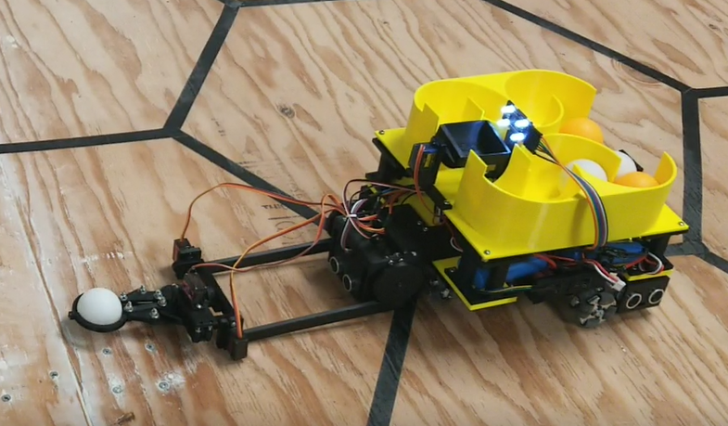
Final Robot design
Glenn Haag

Slide 16
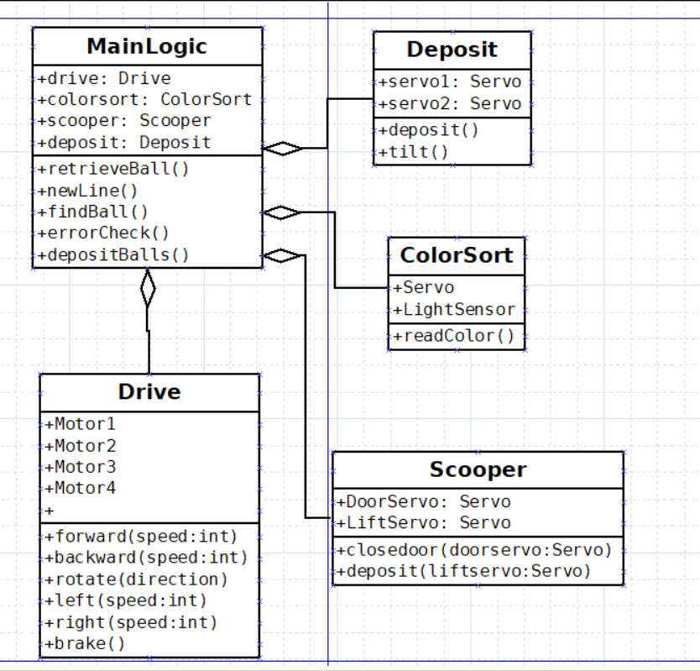
Robot software diagram
Dallas Thornton

Slide 17
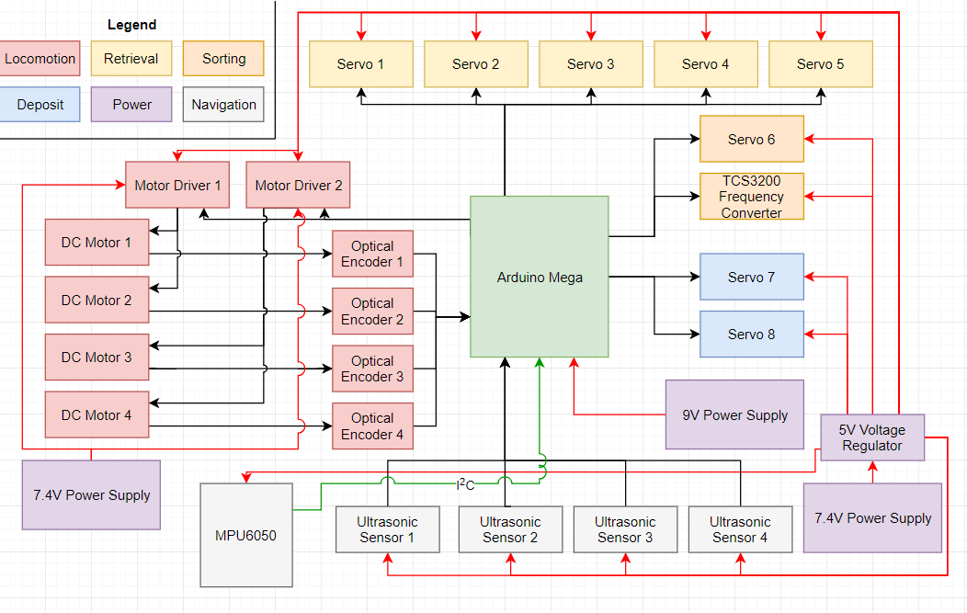
Robot hardware Block diagram
Blake Bennett

Slide 18
Hardware and software testing
Blake Bennett
Bluetooth communication for full system testing.
Serial printing to a monitor for easy debugging and monitoring of sensor values.
Hardware Testing
Individual Component Testing
Full System Testing
Run Program Exhaustively on Practice Field until Hardware Failure
Software Testing
Run Program Exhaustively on Practice Field until Software Failure
Vary Ping Pong Ball Position

Slide 19
Future work
Blake Bennett
Prepare for next year!
We had little interest from underclassmen and were unable to obtain a mentee team.
All future effort on this part should be directed at recruiting a team for next years competition.
Improve Deposit Subsystem software
Currently the deposit system is the weakest part of the software, it is buggy and should be improved in future iterations.
Improve robot speed
This could result in a complete overhaul of the physical robot design.
This would be necessary if the robot were going to the competition.

Slide 20

Questions?

